Slide 1
Joint Discriminative and Generative Learning for Person Re-identification
CVPR 2019
Zhedong Zheng, Xiaodong Yang
Zhiding Yu, Liang Zheng
Yi Yang, Jan Kautz
NVIDIA
CAI, University of Technology Sydney
Australian National University
https://arxiv.org/abs/1904.07223
梁天保

Slide 2
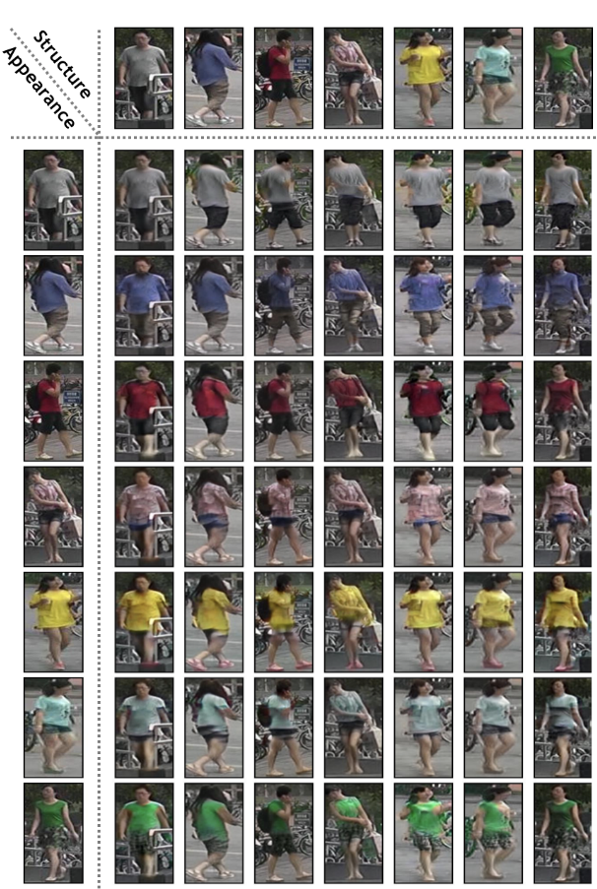
Examples
https://arxiv.org/abs/1904.07223

Slide 3
Examples
https://arxiv.org/abs/1904.07223

Slide 4
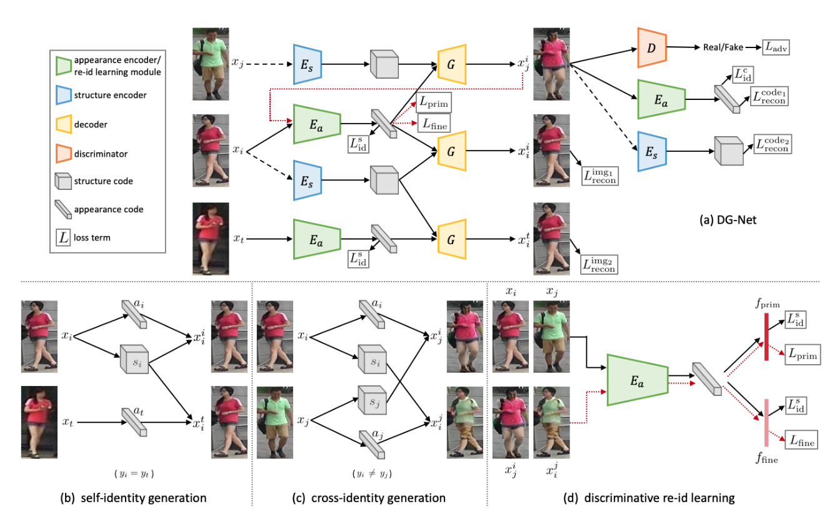



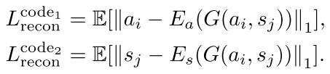




Method OverView
https://arxiv.org/abs/1904.07223

Slide 5
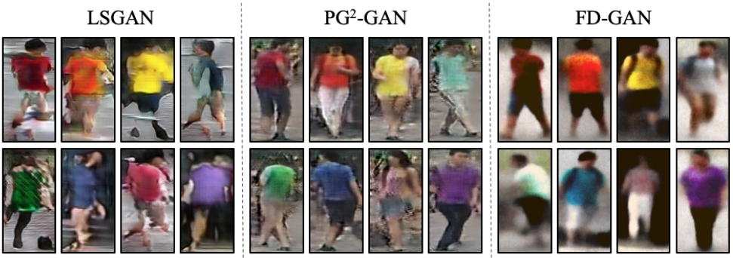
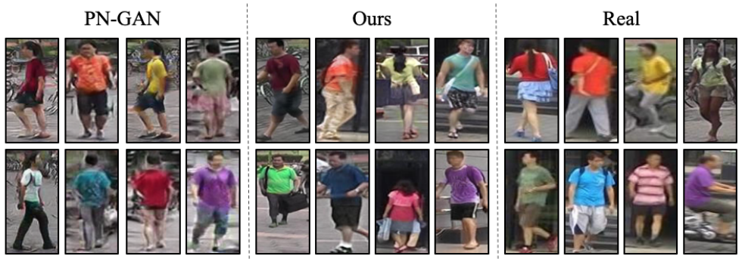
Experiments
https://arxiv.org/abs/1904.07223

Slide 6
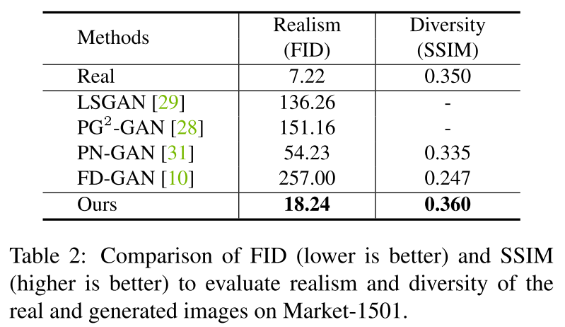
Experiments
https://arxiv.org/abs/1904.07223

Slide 7
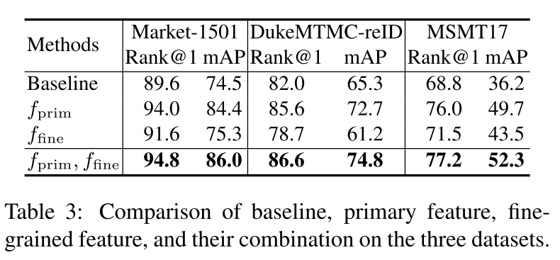
Experiments
https://arxiv.org/abs/1904.07223

Slide 8
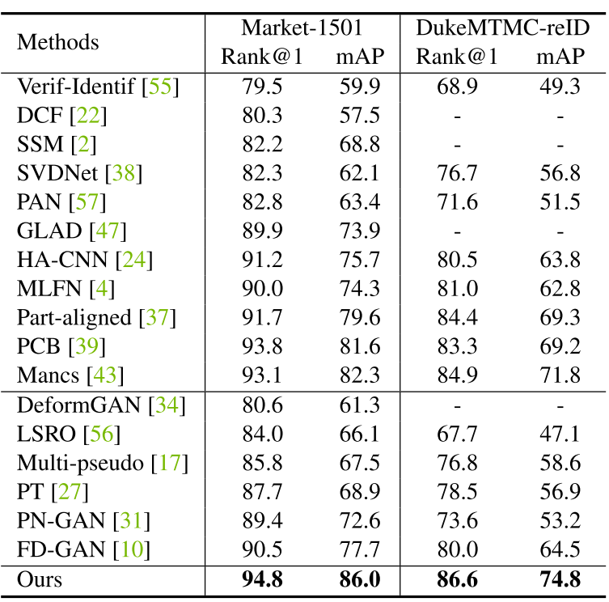
Experiments
Comparison with the state-of-the-art methods on the Market-1501 and DukeMTMC-reID datasets. Group 1: the methods not using generated data. Group 2: the methods using separately generated images.
https://arxiv.org/abs/1904.07223

Slide 9
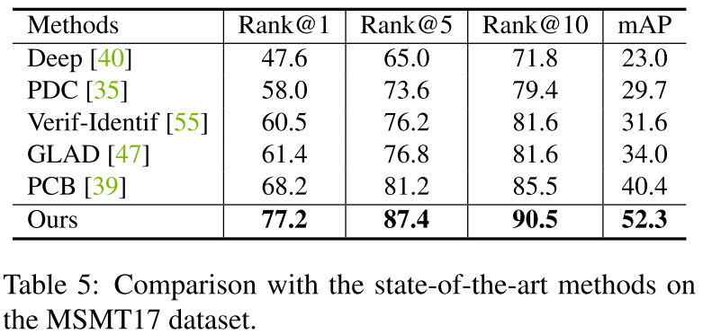
Experiments
https://arxiv.org/abs/1904.07223

Slide 10
Thanks
https://arxiv.org/abs/1904.07223

